Slide 1
The Healthcare Clinic Database
Team #5 - Mary Le, Elle Nguyen, Anthony Bockarie Jr, Mihir Patel

Slide 2
The Healthcare Clinic
Create a lot of data
Require large data storage
Manage interactions between the different parties in healthcare
These interactions and data often are very complicated, but we have created a simplified example of a real life health clinic
Stores data on:
Patients’ Profiles
Healthcare Providers
Bills
Prescriptions
Appointments
Patient Records
Insurance Plans
Relationships between these entities
Notes:
Why is it useful?
What it is?

Slide 3
Possible use cases
MEDICAL RECORD - view the history of a patient, previous illnesses, treatments, and diagnoses.
APPOINTMENT - (patients) view upcoming appointments, (providers) view incoming patients
1
3
2
BILL - store financial summaries and view clinical bills
INSURANCE - store patients’ insurance information (will be encrypted in real life)
4
PATIENT - stores patients’ personal information (appointments, bills, medical records, prescriptions, and visited providers)

Slide 4
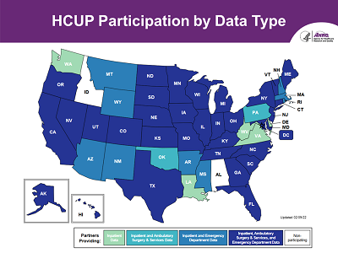
Organizations
There are currently two databases that are popular amounts healthcare providers that our services can add to; Healthcare Cost and Utilization Project (HCUP) and Medicare Provider Analysis and Review (MEDPAR). HCUP provides a patient level data resource that is gathered from many state data organizations. MEDPAR provides a record of all patients that rely on Medicare and measures the quality of a hospital’s staff and facility.

Slide 5
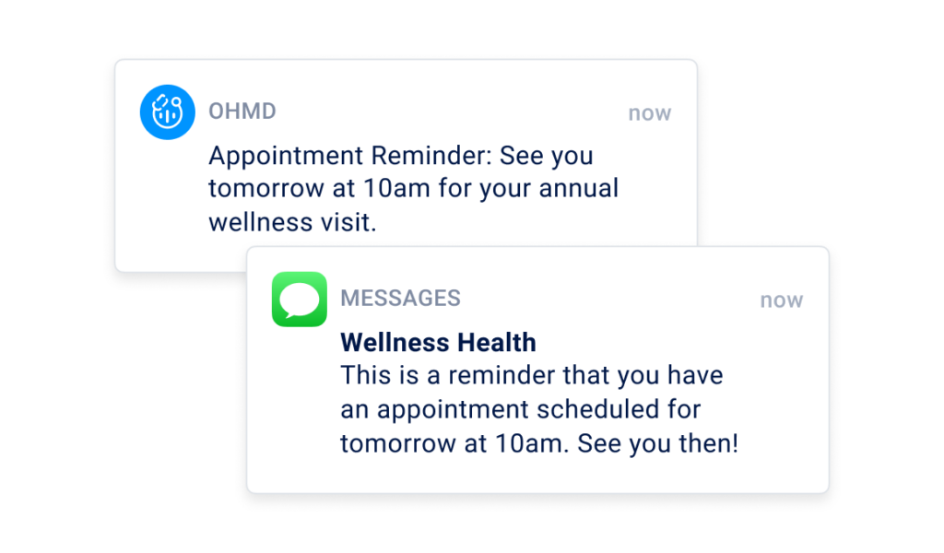
Organizations
Our services allows patients to easily access the appointments that they made and other information. Allowing for a higher user satisfaction, which will elevate the hospital’s overall image.

Slide 6
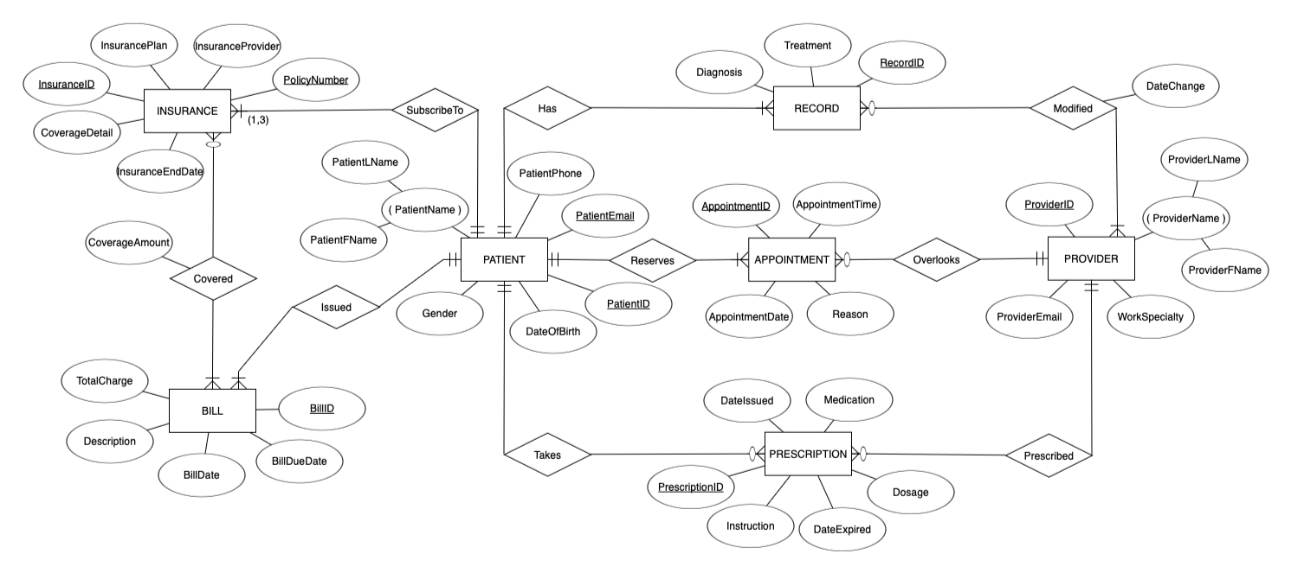
ERD
Notes:
PATIENT: Just like healthcare, the patient ends up being a major part of the database. The main part of the patient entity is how it relates to the other components of the clinic database. Patients can have multiple insurances(3), or just have one. Patients have bills they are responsible for, prescriptions they might take, provider(s) they may see, appointments they reserved, and medical records made about their diagnoses and treatments.

Slide 7
ERD Relationship
- Patient to Insurance: 1 to many
- Patient to Bill: 1 to many
- Insurance to Bill: many to many
Notes:
INSURANCE: Each insurance instance holds one Insurance plan, which only relates to one patient, because each patient has different insurance, and this insurance can be sent many bills.
BILL: The bill has an amount that is to be paid, either by the patient, insurance or a combination of both. The bill is first sent to insurance to see what is covered. Whatever is not, is charged and due by the patient.
PATIENT:
- Each patient must subscribe to at least 1 insurance and can subscribe to at most 3 insurances. Each insurance must be subscribed to by exactly one patient.
- Each patient must be issued at least one bill and can be issued many bills. Each bill must be issued to exactly one patient.

Slide 8
ERD Relationship
- Patient to Record: 1 to many
- Patient to Appointment: 1 to many
- Patient to Prescription: 1 to many
- Record to Provider: many to many
- Provider to Appointment: 1 to many
- Provider to Prescription: 1 to many
Notes:
EMR: The Record is a log of all the interactions patients have had with the clinic. So each medical record can hold a diagnosis and a treatment related to one patient. These records can be accessed and modified by many providers if they need to be.
APPOINTMENT: Each appointment is between one patient and one provider, but obviously a patient can have multiple appointments for different things or with different providers, and providers usually will see multiple patients each day but they don’t have to. This appointment entity can serve both as a schedule and a record of what patients have seen what doctors. PROVIDER: Each provider has basic information like an ID, email, and specialty. Like real life doctors, they can prescribe medications, and also update and modify medical records. Of course their key interaction is with the patients’ appointments which they oversee.
PRESCRIPTION: Each prescription is related to the patient that takes it. Along with this patient, there are instructions, the date they started, the medication, the dosage, and the expiration date of the prescription. These prescriptions are prescribed by the provider that the patient visits.

Slide 9
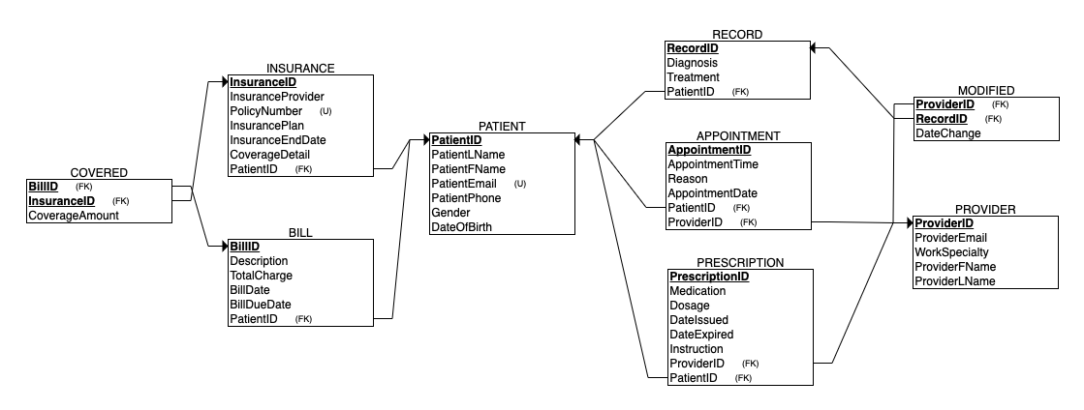
Relational Schema
Notes:
We want create patient table first because it’s the most important and parent table, next we want to create provider table since it’s also another parent table, then insurance and bill table then covered table since covered table is a child table. Next we have record, appointment and prescription table, finally modified table.

Slide 10
Relational Schema (cont.)
CREATE TABLE PATIENT
(
PatientID NUMBER NOT NULL PRIMARY KEY,
PatientLName VARCHAR2(50) NOT NULL,
PatientFName VARCHAR2(50) NOT NULL,
PatientEmail VARCHAR2(100) NOT NULL UNIQUE,
PatientPhone VARCHAR2(20) NOT NULL,
Gender VARCHAR2(10) NOT NULL,
DateOfBirth DATE NOT NULL
);
Notes:
There are 7 attributes in patient table.
Each patient has a patientID so it’s identified as primary key.
Each patient has a unique patient Email so it’s identified as unique
Having all DateOfBirth in Date format so it’s easier for us to query.
For our database, we decide to format all ID primary key in Number. it's better for clarity and consistency

Slide 11
Relational Schema (cont.)
CREATE TABLE APPOINTMENT
(
AppointmentID NUMBER NOT NULL PRIMARY KEY,
AppointmentTime TIMESTAMP NOT NULL,
AppointmentDate DATE NOT NULL,
Reason VARCHAR2(255) NOT NULL,
PatientID NUMBER NOT NULL,
ProviderID NUMBER NOT NULL,
FOREIGN KEY (PatientID) REFERENCES PATIENT (PatientID),
FOREIGN KEY (ProviderID) REFERENCES PROVIDER (ProviderID)
);
Notes:
There are 6 attributes in appointment table.
We have AppointmentID as primary key Bc we want to uniquely identify each appointment
Since appointment is related to both patient and provider so we include patientID and provider ID as foreign key.

Slide 12
TABLE PATIENT &
APPOINTMENT
Our database system keeps track of patients’ personal information as well as appointment details once a patient schedules one (or many) appointments.

Slide 13
Relational Schema (cont.)
CREATE TABLE BILL
(
BillID NUMBER NOT NULL PRIMARY KEY,
Description VARCHAR2(255) NOT NULL,
TotalCharge NUMBER(10,2) NOT NULL,
BillDate DATE NOT NULL,
BillDueDate DATE NOT NULL,
PatientID NUMBER NOT NULL,
FOREIGN KEY (PatientID) REFERENCES PATIENT (PatientID)
);
Notes:
There are 6 attributes in appointment table.
We have BillID as primary key Bc we want to uniquely identify each bill
Since Bill is related to patient so we include patientID as foreign key.
We format total charge as number(10,2) instead of int or float because it provides better control over the precision and scale of monetary values. It ensures that the values are stored accurately and prevents rounding errors that may occur with floating-point or integer types.

Slide 14
Relational Schema
CREATE TABLE INSURANCE
(
InsuranceID NUMBER NOT NULL PRIMARY KEY,
InsuranceProvider VARCHAR2(100) NOT NULL,
PolicyNumber VARCHAR2(50) NOT NULL UNIQUE,
InsurancePlan VARCHAR2(100) NOT NULL,
InsuranceEndDate DATE NOT NULL,
CoverageDetail VARCHAR2(255) NOT NULL,
PatientID NUMBER NOT NULL,
FOREIGN KEY (PatientID) REFERENCES PATIENT (PatientID)
);
Notes:
There are 7 attributes in appointment table.
We have InsuranceID as primary key Bc we want to uniquely identify each insurance
The policy number is formatted unique because there’s a unique policy number for any insurance
Since insurance is related to the patient, we include patientID as foreign key.

Slide 15
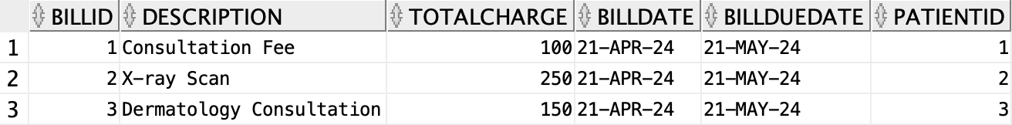
TABLE BILL &
INSURANCE
Our database system keeps track of patients’ personal insurance information as well as billing details from their appointment(s).

Slide 16
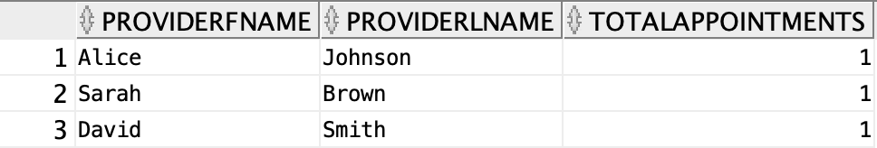
Example Queries
-- Query 1: Get the total number of appointments for each healthcare provider
SELECT p.ProviderFName, p.ProviderLName, COUNT(a.AppointmentID) AS TotalAppointments
FROM Provider p
LEFT JOIN Appointment a ON p.ProviderID = a.ProviderID
GROUP BY p.ProviderFName, p.ProviderLName;

Slide 17
Example Queries (cont.)
-- Query 2: Get the total bill amount, coverage amount, and remaining charged amount for each patient
SELECT p.PatientFName, p.PatientLName, SUM(b.TotalCharge) AS TotalBillAmount,
SUM(c.CoverageAmount) AS TotalCoverageAmount,
(SUM(b.TotalCharge) - SUM(c.CoverageAmount)) AS TotalRemainingCharged
FROM PATIENT p
JOIN BILL b ON p.PatientID = b.PatientID
LEFT JOIN Covered c ON b.BillID = c.BillID
GROUP BY p.PatientFName, p.PatientLName;

Slide 18
Thank you for listening!

